Slide 1
Engineer Data for Business Insights Team 06 – JinHui, Jeremy Gan
Date: 5 Feb 2026

Slide 2
Problem Statement
What problem are we solving?
NEA's current weather forecasting services provide broad, city-wide predictions (e.g., "Thunderstorms in the afternoon") that lack the spatial and temporal granularity needed for members of public to make confident, real-time decisions about outdoor commutes, activities, and daily planning in Singapore's hyper-local tropical climate.
Despite NEA's extensive network of meteorological sensors and access to satellite data, this wealth of raw data is not yet translated into personalised, location-specific, and actionable weather intelligence at the street level. As a result, the public often experiences a gap between the forecast they receive and the weather they actually encounter — leading to disrupted plans, safety concerns, and diminished trust in public weather services.
What is the business value of addressing the problem?
Impact Area | Description
Public Trust & Service Excellence | Delivering hyper-local, AI-driven predictions elevates NEA's reputation as a world-class weather authority, increasing public confidence and engagement with government digital services
Operational Efficiency | Automating the prediction pipeline — from satellite/sensor ingestion to API delivery — reduces manual forecasting workload and enables NEA officers to focus on severe weather events and policy
Data-Driven Governance | Aggregated search and usage analytics reveal how and where the public seeks weather information, informing infrastructure planning, urban heat island studies, and climate adaptation strategies
Smart Nation Alignment | Demonstrates Singapore's leadership in applying AI + IoT to public services, contributing to Smart Nation and GreenPlan 2030 sustainability objectives

Slide 3
Success Metrics
🏛️ Public Trust & Service Excellence
50K
Monthly Active Users (12 mths)
App analytics
<0.5mm
Forecast vs Actual Deviation (MAE)
Prediction vs actual readings
⚙️ Operational Efficiency
≥90%
Forecasting Automation Rate
No manual intervention
99.5%
Pipeline Uptime
Monitoring dashboard
📊 Data-Driven Governance
Top 50
Searched Locations
Aggregated search analytics
≥80%
Sensor Utilisation Rate
% of NEA sensors consumed
≥60% Repeat Usage Rate (7-day) Returning users within 7 days
<5min
Anomaly-to-Alert Response Time
Data anomaly to notification
📈
Search Query Volume Trend
Monthly API logs
🇸🇬 Smart Nation Alignment
Open Data API Published
data.gov.sg listing
AI Model Transparency
Model card publication

Slide 4
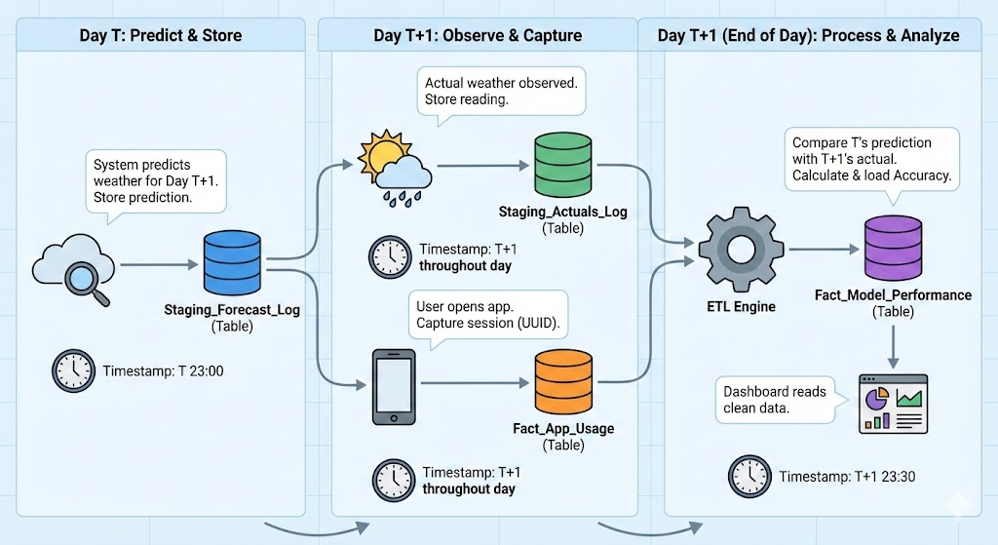
Process Flow Chart

Slide 5
Data Process Flow Chart
Collect Raw Data
Cloud Images from Japan satellite (Himarwari-8/9)
Pre-Processing
Cleansing
Model Training Strategy
Forecast
Forecast based on the user’s enquire
Store the data (location, forecast outcome and user account for further improvement on accuracy of the model
Raining, temperature, humanity and PM2.5 from data.gov.sg
All data will be kept in data lake (S3 bucket) for pre-processing processing
Timestamp Alignment Strategy (Resample to unified frequency)

Slide 6
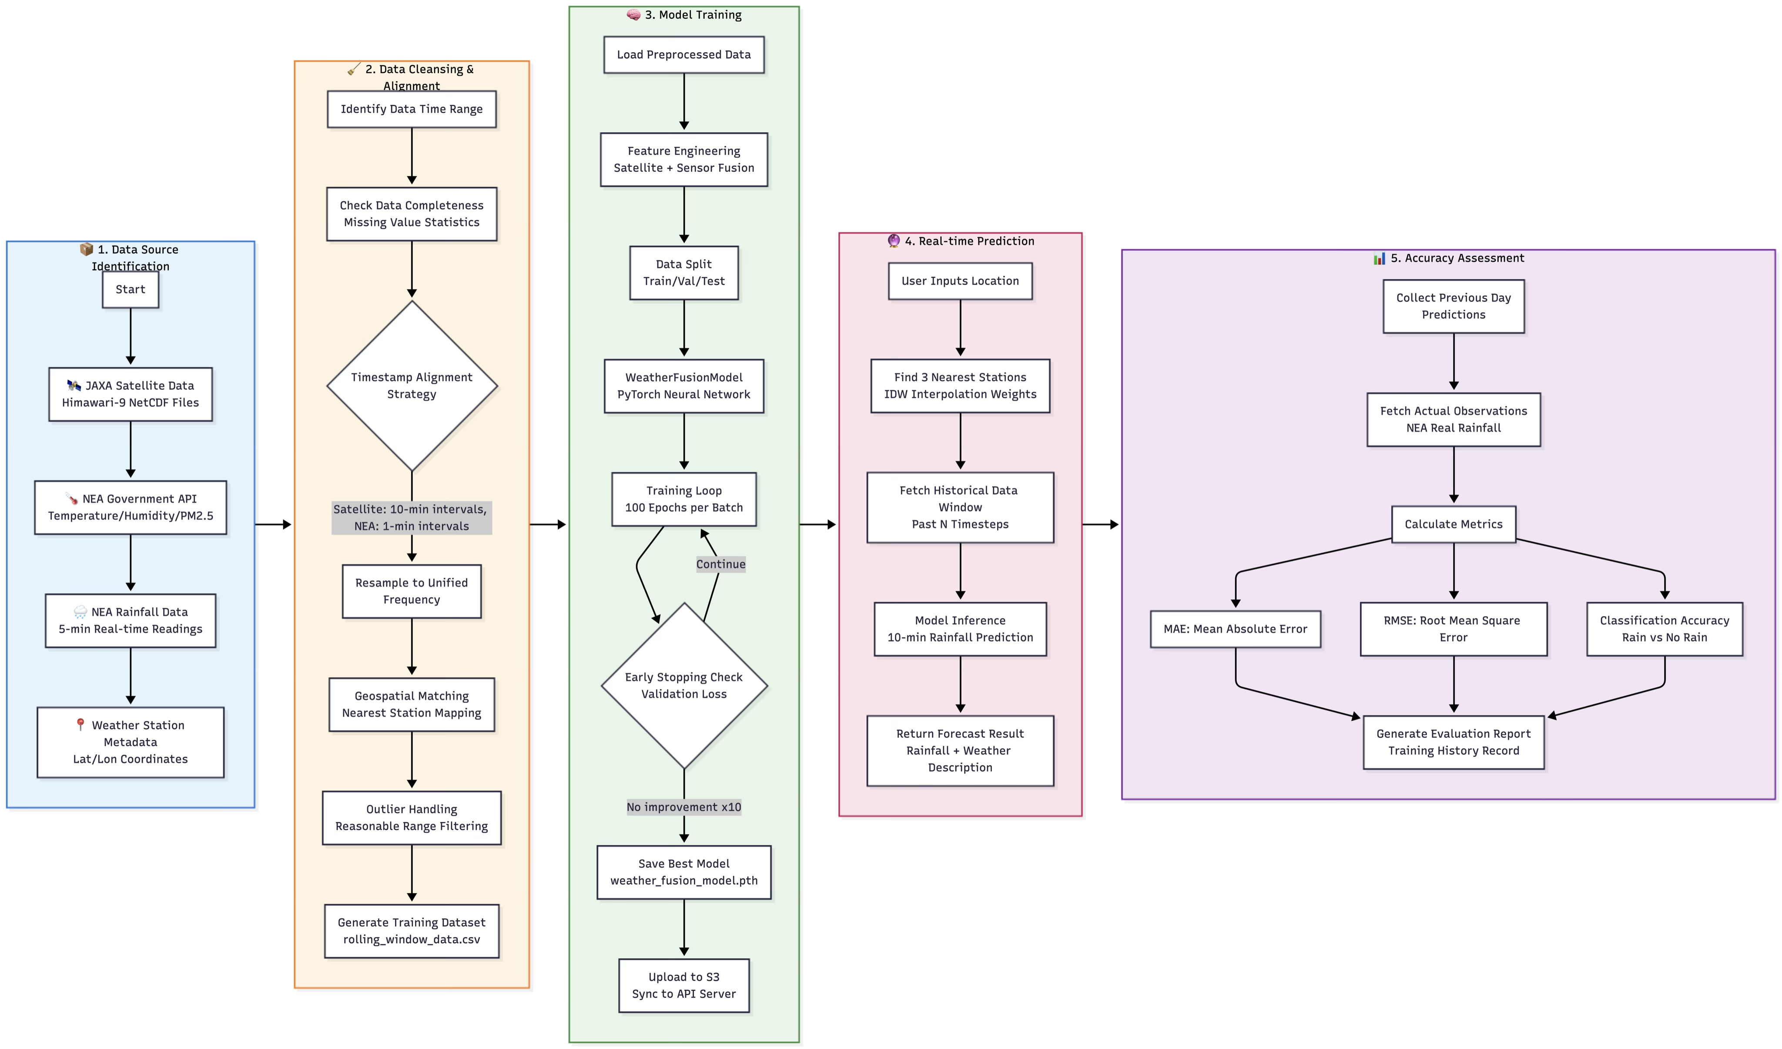
Detailed Step Process Flow Chart

Slide 7
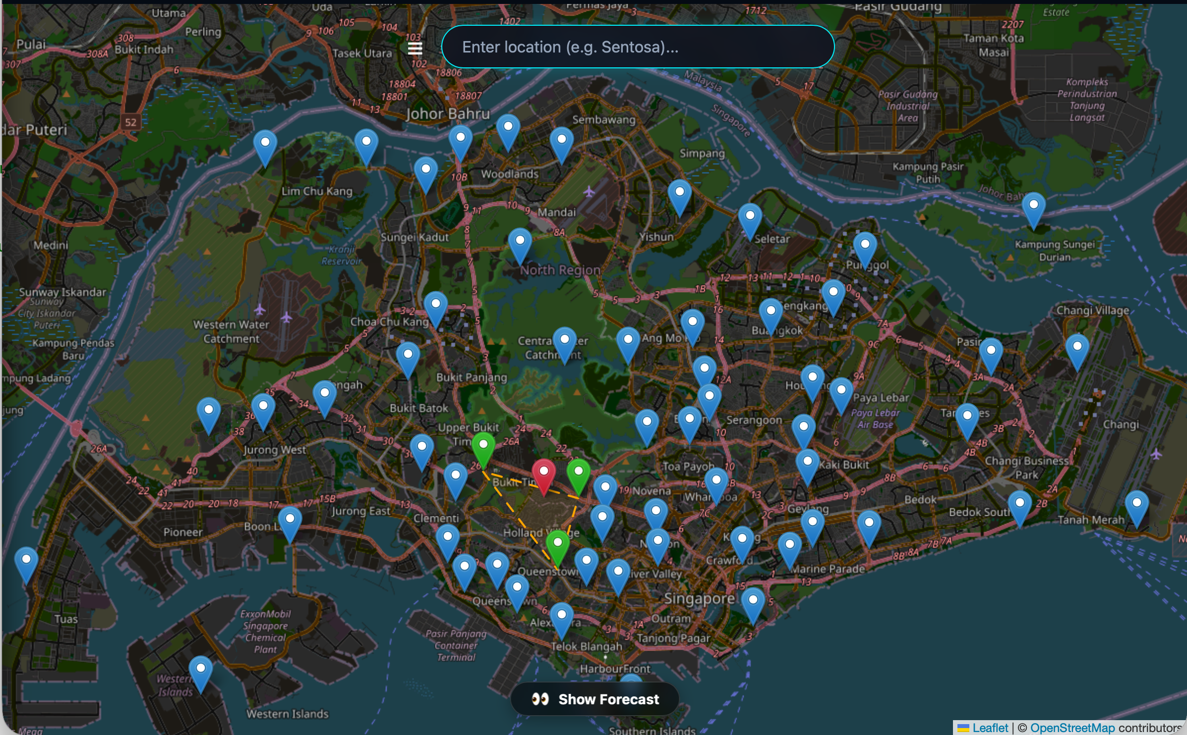
🌦️ Singapore Weather AI
AI-Powered Rainfall Prediction System
Satellite + Sensor Data Fusion • Deep Learning • Real-Time API
🛰️
Himawari-9
Satellite Data Source
📡
NEA API
Sensor Data Source
🧠
CNN+LSTM
Fusion Model
⚡
<200ms
Prediction Speed

Slide 8
Feather 1 – Data Ingestion & Processing
Satellite Data
Himawari-9 infrared imagery from JAXA FTP
Sensor Data
NEA API: Temperature, Humidity, Rainfall, PM2.5
Batch download + incremental updates
Auto-crop Singapore region
Parallel download (xargs -P)
NetCDF → NumPy conversion
SSL certificate verification
Auto-resample to 10-min intervals
Smart timestamp alignment (UTC ↔ SGT)
100% satellite-sensor data parity

Slide 9
Feather 2 – Deep Learning Fusion Model
3-layer CNN + BatchNorm + AdaptiveAvgPool
LSTM temporal encoder for sensor sequences
Dropout-regularized fusion head
10-minute ahead rainfall prediction
GPU / CPU / Apple MPS adaptive
Incremental learning with checkpoint loading
Smart 3→4 feature dimension migration
Dynamic epochs (initial: 100, incremental: 5)

Slide 10
Feather 3 – Automated Training System
🔧 PreProcess
🧠 Train
📄 Report
📊 Evaluate
📧 Email
📥 Download
Daily Pipeline🔄
End-to-end automation
Batch Scheduler📅
Day-by-day historical training
History & Reporting📊
Training metrics tracking
Failure auto-retry
HTML report generation
Gmail email notifications
S3 data readiness detection
Train → Cleanup → Archive
Real-time dashboard sync
Performance trend analysis
S3 checkpoint persistence
Rolling window training

Slide 11
Feather 4 – Prediction API Service
Endpoint | Method | Description
/predict | GET | Single-point prediction by location name or lat/lon coordinates
/predict/path | GET | Path weather prediction — sampling every 2km along route
/health | GET | Service health check
/stations | GET | Weather station metadata and locations
/log-search | POST | Log user search history
/popular-searches | GET | Popular search ranking and statistics
🔢IDW Interpolation
Inverse Distance Weighting using 3 nearest sensors for spatial accuracy
🗺️OpenStreetMap
Forward/reverse geocoding for location name and coordinate resolution
♻️Model Hot-Reload
Automatic model refresh from S3 without service restart

Slide 12
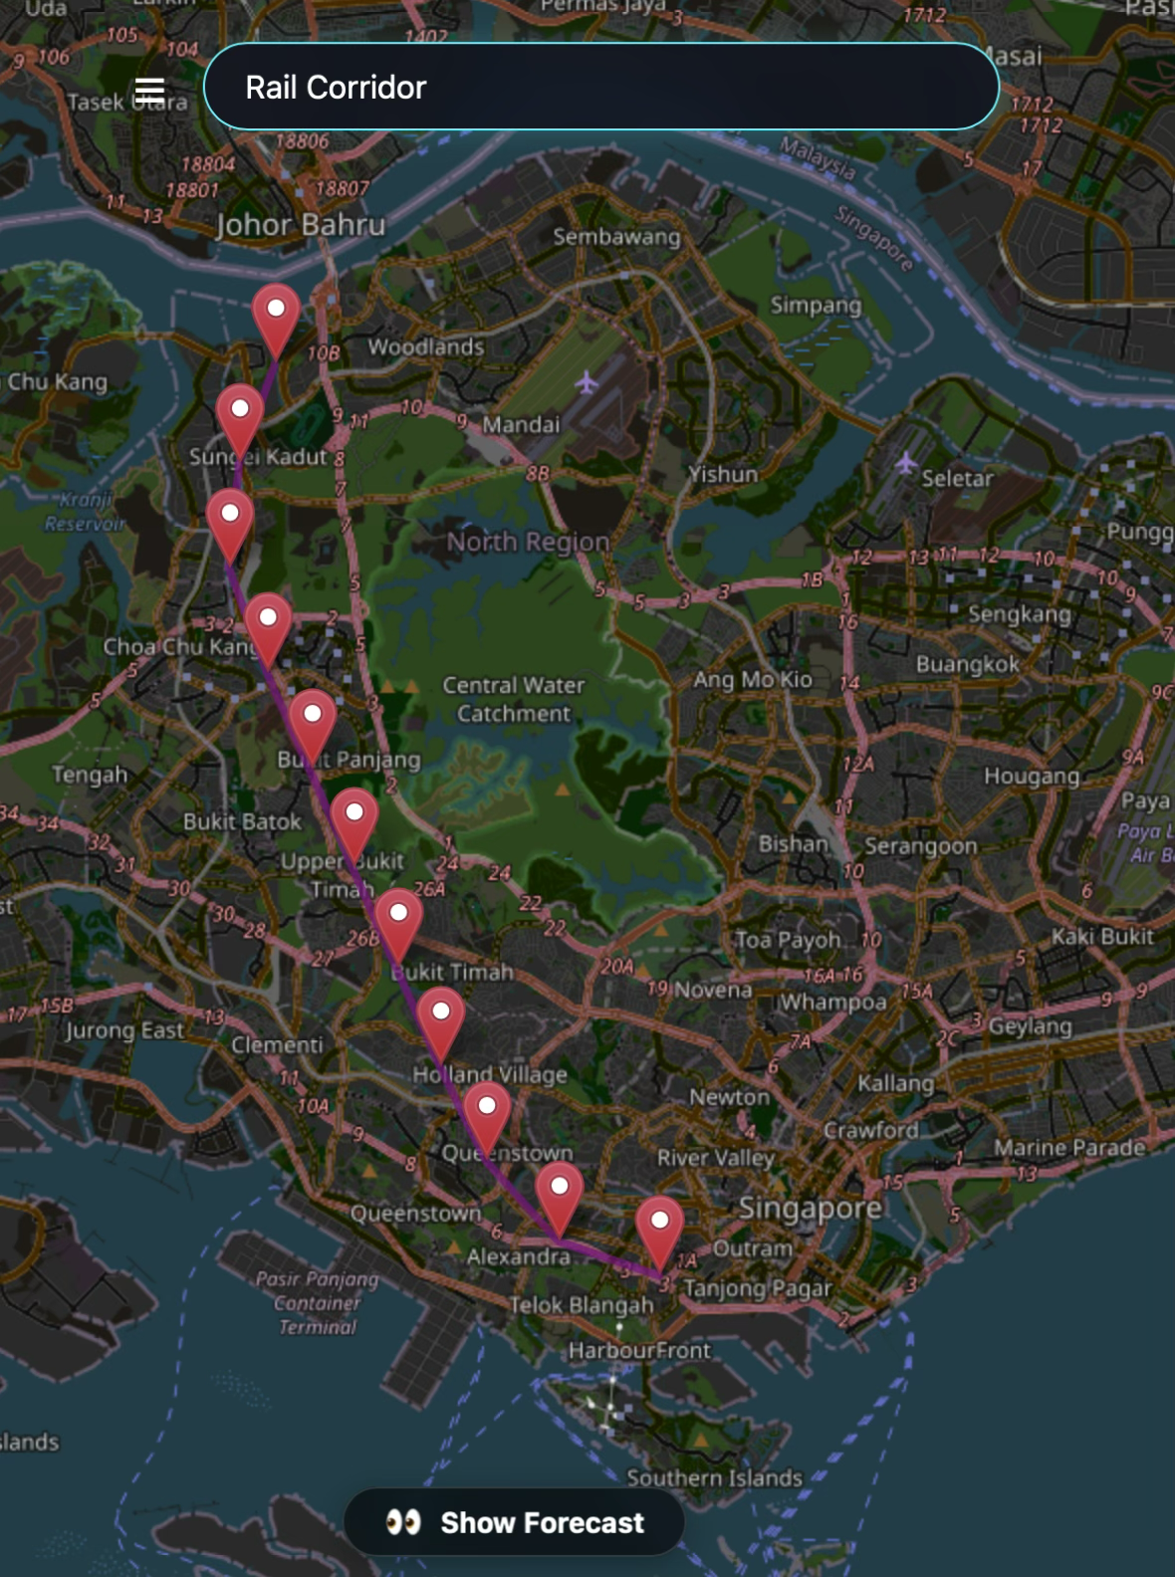
Feature 5 – Frontend Application
🗺️
Interactive Map & Prediction
Leaflet map — click anywhere for prediction
Path/landmark search with route weather
Weather station markers (configurable)
Forecast panel: rainfall, temperature, humidity
Weather icon animations
Quick search links
⚙️
App Features
React + TypeScript + Vite
Responsive design (desktop + mobile)
Side navigation menu
Settings with localStorage persistence
Search analytics (Stats page)
Global ConfigContext for state management
Example: “Rail Corridor”, “East Coast Park”
Fetches route geometry from OpenStreetMap
Samples points along the path
Predicts weather at each sample point
Visualises path with color-coded forecast markers

Slide 13
Feature 6 – Monitoring Dashboard
📥
File Download Tab
Daily download progress
Completed days counter
Satellite file count
NEA data file count
Per-day status table
🧠
Training Process Tab
4-phase progress stepper
Current batch & epoch count
Training history table
MAE / RMSE metrics
Success/failure status
🚀
API Application Tab
Model sync status
Sensor data sync status
Last sync timestamp
Service health indicator
Log viewer with highlighting

Slide 14
Feature 7 – Operational
System Metrics
MAE (Mean Absolute Error)
DevOps
Automation & Sync
Environment Separation
Tech Stack
PyTorch
React
TypeScript
Infra
Download Server
Training Server
API Server
S3 Data Lake
Cloudfront
Terraform
RMSE
Accuracy
Requests / Second
Path Prediction
Single Point Prediction
Bidirectional S3 Sync

Slide 15
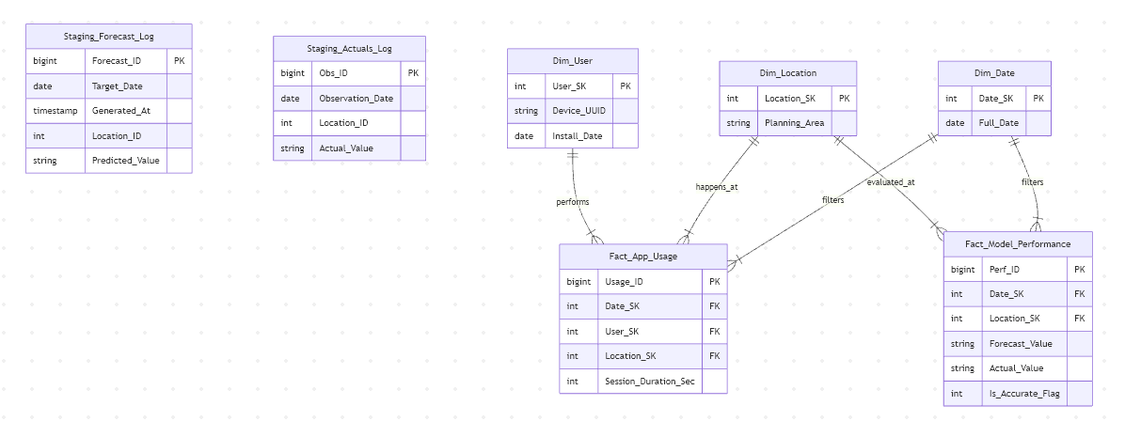
ER Diagram

